Slide 1
DSC530 Final Project
Nicholas Miller
August 11th, 2019

Slide 2
Accidental Drug Related Deaths 2012-2018 in Connecticut
Dataset retrieved from: https://catalog.data.gov/dataset/accidental-drug-related-deaths-january-2012-sept-2015

Slide 3
Variables
Year – The year the subject died from drug overdose
Age – The age of the subject
Sex – The sex of the subject
Race – The race of the subject
Drug – The name of the drug used to overdose
Note – If more than one drug was detected, drug type is set to ‘Multiple’

Slide 4

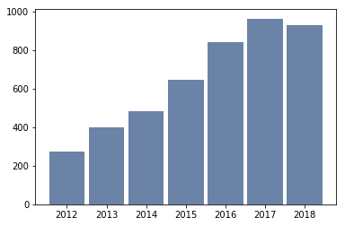
Histograms
YEAR
Mean: 2015.7617
Mode: 2017
Variance: 3.2997
Standard Deviation: 1.8165

Slide 5
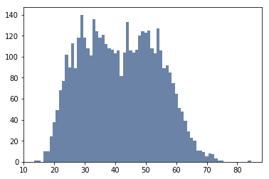
Histograms
AGE
Mean: 41.5790
Mode: 29
Variance: 150.7958
Standard Deviation: 12.2799

Slide 6
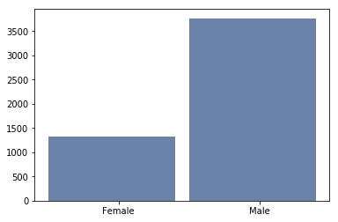
Histograms
SEX
Male: 3403
Female: 1134

Slide 7
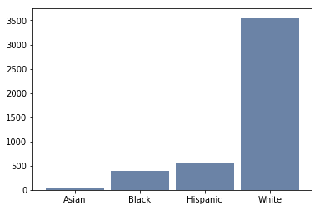
Histograms
RACE
Asian: 31
Black: 395
Hispanic: 546
White: 3565

Slide 8
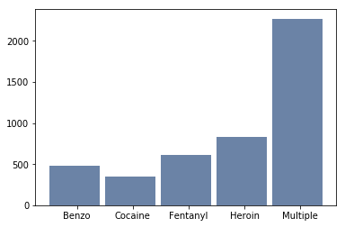
Histograms
DRUG
Benzodiazepines: 476
Cocaine: 349
Fentanyl: 608
Heroin: 834
Multiple: 2270

Slide 9
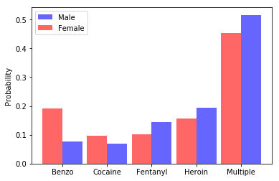
PMF
Male vs. Female
The female population overdosed more on benzos and cocaine, while the male subjects overdosed more on fentanyl, heroin, and combinations of the drugs.

Slide 10
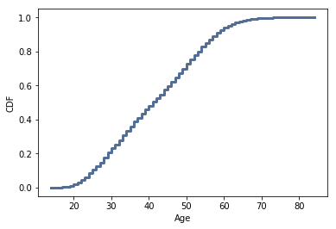
CDF
Age
The ‘age’ variable is distributed normally, with about 95% of all subjects falling within the range of 21 to 63.

Slide 11
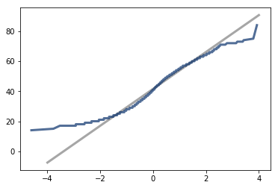
Normal Distribution
The age of subjects is normal within 2 standard deviations, but since the mean is about 42, and the standard deviation is about 12, that puts the low end of 2 standard deviations at 18, which hopefully there would not be too many people overdosing from drugs at any age lower than that. Also, at 2 standard deviations above the mean, 66, prescription medications may be controlled by guardians or caretakers, so as not to increase the chance of overdose or combining medications that could produce deadly results.

Slide 12
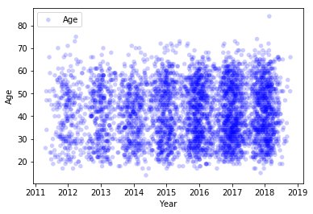
Scatter Plots
Age vs. Year
Here we can see a dense cluster on the right, meaning that as the years go on, the deaths from overdoses increase. There does not seem to be much correlation to age, as the low Pearson Correlation value confirms (0.033).

Slide 13
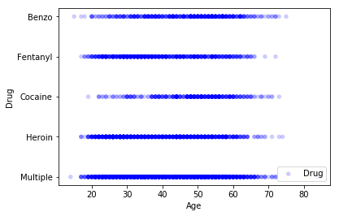
Scatter Plots
Drug vs. Age
This scatter plot does not really show much correlation to age and drug type, but it does show that cocaine overdoses tend to happen a bit later in life, compared to the other drugs.

Slide 14
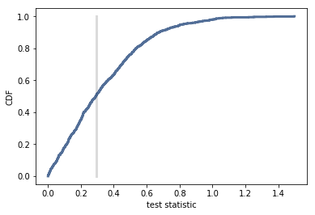
Hypothesis Testing
The hypothesis here is that gender determines likelihood of drug overdose. The null hypothesis is that it does not. With a p-value of 0.493, it is not statistically significant. The CDF intersects the observed difference at .507, which means that we expect to see a difference as big as the observed effect about half of the time.

